Slide 1
Vinco is a platform that enables company to offer education as a benefit to its employees
Context
Vinco is a startup that looks to educate the uneducated
Vinco links education institutions, employers and employees through a webapp
Vinco offers coaches that help users (employees) navigate through education and professional opportunities
Coaches keep track of their assigned students through their education/career progress

Slide 2
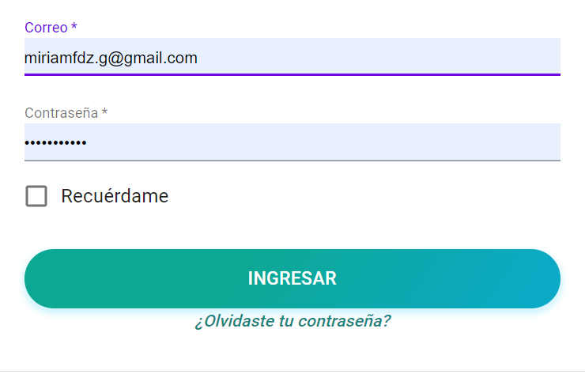
User story wireframe – Log in for Coaches
I am a coach at Vinco and want to log in to my coach account
I am a coach trying to recover my password

Slide 3
Page for students to write their data
Student
Education Program
Writes Student data to the back end
Company
Contact Info

Slide 4
General Roster
Enrolled students
New students waiting to be enrolled
#
Reads contacted students from backend
By current coach
#
#
#
Students contacted
# of enrolled students
Dropped out students
Failing students
#
Reads non-contacted students from backend
Students waiting to be contacted
I am a coach at Vinco and want to know how many students I have in charge
I am a coach at Vinco and want to know how my students are doing
I am a coach at Vinco and want to know how many students are waiting to be enrolled

Slide 5
Page for coaches to say they have contacted students
These students can be seen by ALL coaches
Student
Education Program
Company
Contact Info
Contacted
Reads: non-contacted students
Writes: moves from non-contacted to contacted
Name of student
Type of program
Company Name
No
Once clicked, it is assigned to a coach
Name of student
Type of program
Company Name
No
Name of student
Type of program
Company Name
No

Slide 6
Dashboard to see assigned students and status
Student
Education Program
Company
Motivation Level
Last contact
Status
Name of student
Type of program
Company Name
1-5
Date
Name of student
Type of program
Company Name
1-5
Date
Name of student
Type of program
Company Name
1-5
Date
Double click on student (next slide)
I am a coach at Vinco and want to see how all my current students are doing
I am a coach at Vinco and want to see what students I must contact

Slide 7
Double click to see communication frequency with students and let coach know they need to reach out
Date
Subject of conversation
Coach Notes
Date
Subject of conv. (App. questions, trouble with program, etc.)
Coach notes.
I am a coach at Vinco and want to see notes on my previous conversations with students

